Slide 1

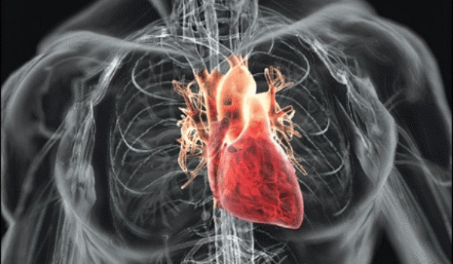


Cardiovascular Risk Dashboard
What : Dashboard that gives “Health of Heart” for a population as well as an individual
Why : Clinical data analysis to avoid potential Drug-induced QT Interval Prolongation in patients
How : Multi-Tier architecture with Java stack
MS SQL / Oracle + Crawler (Java service) + CCL - Backend
Java / J2EE + JSP – Business Layer
JS, JQuery, AJAX, HTML, CSS – Frontend
Who : Two Engineers (Including me) + one Physician as SME.

Slide 2


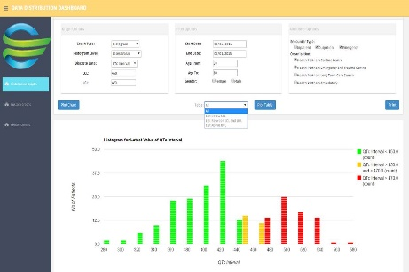









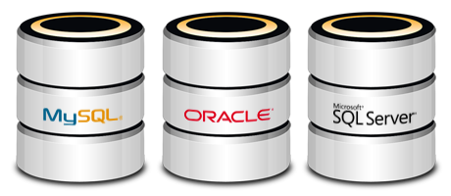









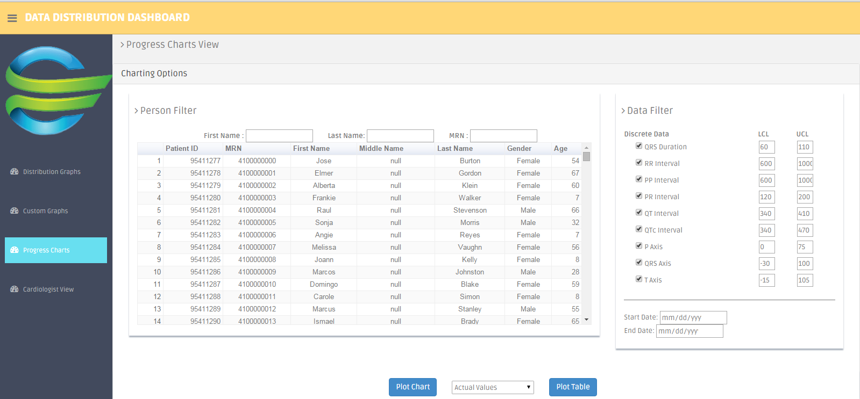
CVRD Flow Diagram
Analyzer
OPMA DB
Data Manager
Crawler
Clinical DB
Client
Pop Health
Health Facts

Slide 3

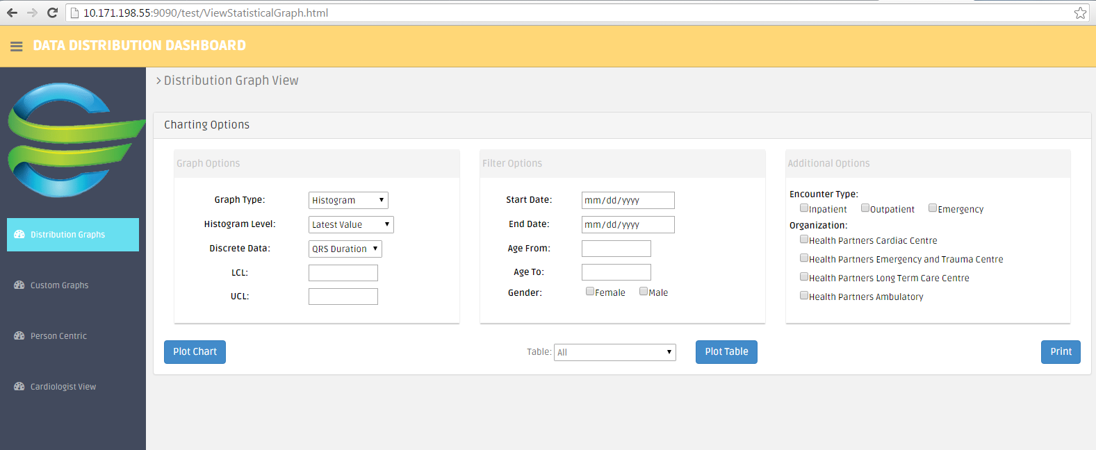




Filter Input
Analyzer
GraphDataGenerator
Dynamic Query Builder Layer
GraphData
GraphDataHistogram
GraphDataPie
GraphDataScatter
GraphDataPatient
Histogram Chart
Data Manager
FetchGraphData
OPMA DB
FetchGraphDataHistogram
FetchGraphDataPie
FetchGraphDataScatter
FetchPatientProgressData

Slide 4


